Slide 1
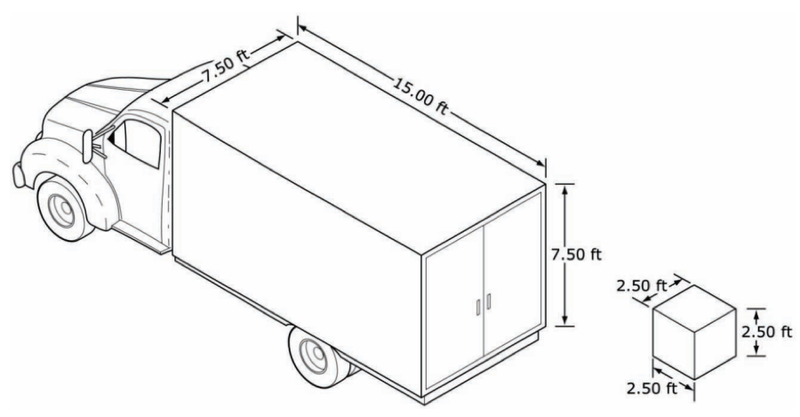
Moving Houses
Notes:
SET – Ask students what they learnt last period (using popcorn strategy)? - i.e Measuring volume and formula for the volume of a prism
Ask student if they can solve the problem from last class now?
Scenario – ‘I am moving houses next week. One of my friends have offered to help by lending her the truck. I have packed my goods in cubic packing boxes with side length of 2.5 ft. If the Truck has the dimensions as given, how many boxes can I fit in the Truck?’
Solution – I can put in 54 boxes [3*3*6 or (7.5*15*7.5/2.5^3)]

Slide 2
Volume - 2
Mr Parekh

Slide 3
Learning Intention
Success Criteria
Students will be able,
Recall formula for calculating volume of prism
Using the formula find the volume of prisms.
You will
Complete the three handouts.
Notes:
This lesson will focus on guided/independent practice to practice the skills developed in the last lesson.

Slide 4
Guided Practice
Math Antics Worksheets.
Notes:
Find the Handout in the folder.

